Slide 1

Raspberry Pi Computer Vision
Lecturer: Reza Arjmandi
Summer 2016
Preface:
Computer vision (CV) allows your Raspberry Pi to see things. In practical terms, this means that your Raspberry Pi can analyze an image, looking for items of interest and even recognizing faces and text.

Slide 2
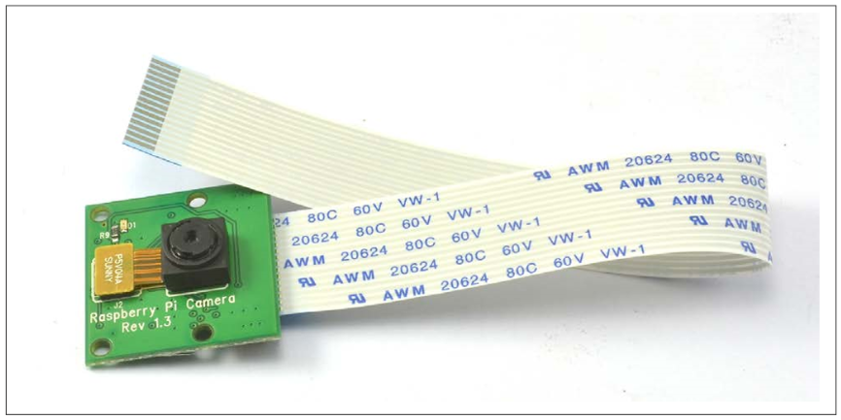
Installing the Raspberry Pi Camera Module
You want to use the Raspberry Pi camera module
The Raspberry Pi camera module (following Figure) is attached to a Raspberry Pi by a ribbon cable.

Slide 3
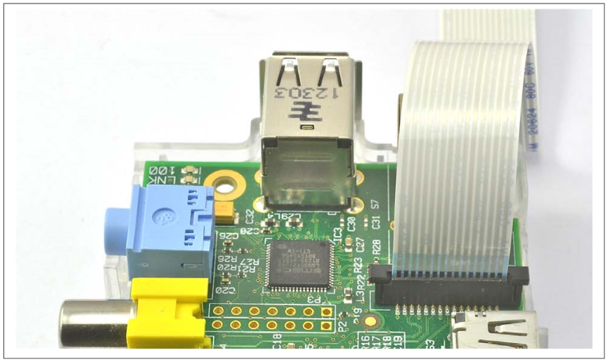
Installing the Raspberry Pi Camera Module
This cable attaches to a special connector just behind the Ethernet socket. To fit it, pull up the levers on either side of the connector, so that they unlock, and then press the cable into the slot with the connector pads of the cable facing away from the Ethernet socket. Press the two levers of the connector back down to lock the cable in place ( following Figure).

Slide 4
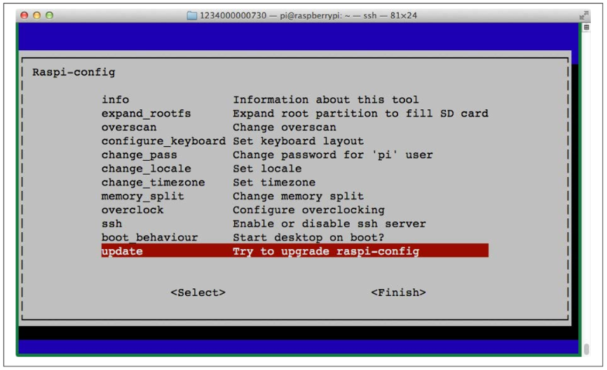
Installing the Raspberry Pi Camera Module
NOTE: The camera module packaging states that it is sensitive to static. So, before handling it, ground yourself by touching something grounded like the metal case of a PC.
The camera module requires some software configuration. The easiest way to configure it is to use raspi_config . To run raspi-config, enter the following command into a Terminal session.
$ sudo raspi-config
You will then see a list of options like those shown in following Figure

Slide 5
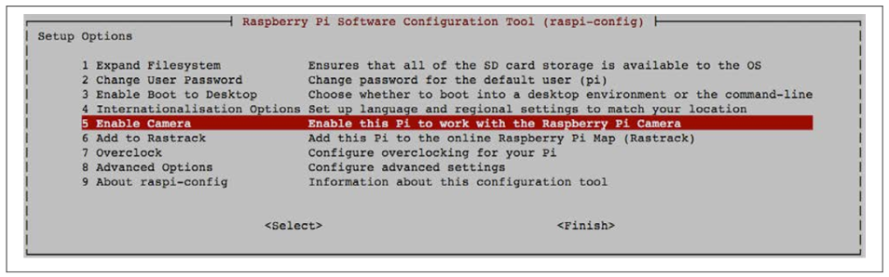
Installing the Raspberry Pi Camera Module
If the option Camera is not in the list, then you need to update the operating system by running the following commands in a Terminal session:
$ sudo apt-get update
$ sudo apt-get upgrade
You need an Internet connection to do this. The second of these commands may take a few minutes to complete. When they are complete, reboot your Raspberry Pi.
Now, when you run raspi-config you will see the option to enable the camera (following Figure).

Slide 6
Installing the Raspberry Pi Camera Module
Two commands are available for capturing still images and videos: raspiStill and raspivid.
To capture a single still image, use the raspiStill command as shown here:
$ raspistill -o image1.jpg
A preview screen displays for about five seconds and then takes a photograph and stores it in the file image1.jpg in the current directory.
To capture video, use the command raspivid:
$ raspivid -o video.h264 -t 10000
The number on the end is the recording duration in milliseconds—in this case, 10 seconds.
Both raspstill and raspivid have a large number of options. If you type either command without any parameters, help text displays options that are available.
An alternative to the camera module is to use a USB webcam

Slide 7
Installing SimpleCV
To install SimpleCV, first install the prerequisite packages using these commands:
$ sudo apt-get update
$ sudo apt-get install ipython python-opencv python-scipy
$ sudo apt-get install python-numpy python-setuptools python-pip
$ sudo pip install svgwrite
Then install SimpleCV itself using the command:
$ sudo pip install https://github.com/sightmachine/SimpleCV/zipball/master

Slide 8
Installing SimpleCV
Once installation is complete, you can check that everything worked by running this command:
$ simplecv
+-----------------------------------------------------------+
SimpleCV 1.3.0 [interactive shell] - http://simplecv.org
+-----------------------------------------------------------+
Commands:
"exit()" or press "Ctrl+ D" to exit the shell
"clear()" to clear the shell screen
"tutorial()" to begin the SimpleCV interactive tutorial
"example()" gives a list of examples you can run
"forums()" will launch a web browser for the help forums
"walkthrough()" will launch a web browser with a walkthrough
This will open the SimpleCV console. This is a Python console, with extra features for SimpleCV

Slide 9
Installing SimpleCV
SimpleCV is a Python wrapper around the OpenCV computer vision software. SimpleCV, as the name suggests, simplifies the use of OpenCV. If you want to unleash the full power of OpenCV, take a look at http://opencv.org/.
Computer vision is both processor- and memory-intensive, so although SimpleCV and OpenCV will work on an older Raspberry Pi, it can be frustratingly slow on anything earlier than a Raspberry Pi 3 or 2.

Slide 10
Setting Up a USB Camera for Computer Vision
Use a USB webcam that is compatible with the Raspberry Pi (see http://elinux.org/ RPi_USB_Webcams). Choose a good quality camera, and if you are working on a project where you need the camera close to the subject, select one that has a manual focus option. For getting really close to the subject, a low-cost USB endoscope can be useful.

Slide 11
Setting Up a USB Camera for Computer Vision
You can test out your USB camera from the SimpleCV console. Start SimpleCV and then enter the commands shown below in bold:
SimpleCV:1> c = Camera()
VIDIOC_QUERYMENU: Invalid argument
VIDIOC_QUERYMENU: Invalid argument
VIDIOC_QUERYMENU: Invalid argument
VIDIOC_QUERYMENU: Invalid argument
VIDIOC_QUERYMENU: Invalid argument
VIDIOC_QUERYMENU: Invalid argument
VIDIOC_QUERYMENU: Invalid argument
SimpleCV:2> i = c.getImage()
SimpleCV:3> i
SimpleCV:3: <SimpleCV.Image Object size:(640, 480), filename: (None), at memory location: (0x2381af8)>
SimpleCV:4> i.show()
Don’t worry about the Invalid argument messages.
When you issue the command i.show(), a second window opens showing the image just captured from the camera.

Slide 12
Using a Raspberry Pi Camera Module for Computer Vision
You want to use a Raspberry Pi Camera Module that connects directly to your Raspberry Pi with Simple CV.
The Raspberry Pi Camera Module does not automatically show up as a camera device. The easiest way to make the module work with SimpleCV is to use the picamera Python module to capture an image with the camera.
The following code fragment will use picamera to capture an image, save it to a temporary file, and then load it as an Image suitable for use with SimpleCV
import picamera
from SimpleCV import *
def get_camera_image():
with picamera.PiCamera() as camera:
camera.capture('tmp.jpg')
return Image('tmp.jpg')

Slide 13
Using a Raspberry Pi Camera Module for Computer Vision
The picamera module allows you to set various features of the camera. Most usefully, you can control the resolution, automatic exposure, and white-balance adjustments, which can make it easier to get consistent results with CV.
The native resolution of the camera is 2592×1944, which will make for pretty slow image processing, so you may want to set the resolution to something closer to 1024×768 and turn off auto-white balance. The get_camera_image function can be modified to include these settings, as shown here:
import picamera
from SimpleCV import *
def get_camera_image():
with picamera.PiCamera() as camera:
camera.resolution = (1024, 768)
camera.awb_mode = 'off'
camera.capture('tmp.jpg')
return Image('tmp.jpg')

Slide 14
Using a Memory Stream
import picamera
import SimpleCV
import PIL
from io import BytesIO
camera = picamera.PiCamera()
camera.resolution=(320,240)
camera.framerate=24
def get_camera_image():
buf = BytesIO()
camera.capture(buf, "rgb")
im = PIL.Image.frombuffer("RGB", (320, 240), buf.getvalue(), "raw", "RGB", 0,1)
result = SimpleCV.Image(im)
return result

Slide 15
Counting Coins
Use SimpleCV and its findCircle function to provide a real-time count of the number of coins placed under the webcam.
Before writing a Python program that will simply tell you the number of coins your Raspberry Pi can see, you need to experiment with the SimpleCV console to get the parameters for circle recognition right.
Start SimpleCV by using the command simplecv and then enter the commands below to start the camera, capture an image, and then display it in a separate window.
SimpleCV:1> c = Camera()
SimpleCV:2> i = c.getImage()
SimpleCV:3> i.show()

Slide 16
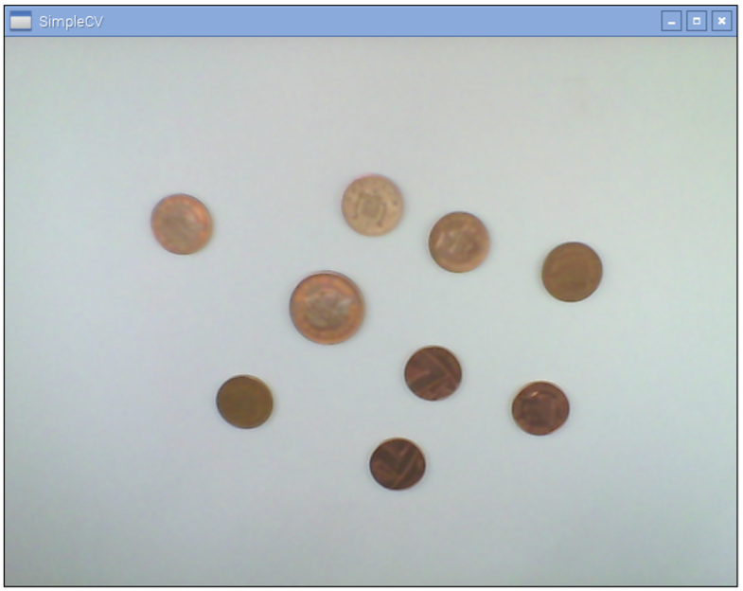
Counting Coins
This should open up an image of your coins that looks something like following figure:

Slide 17
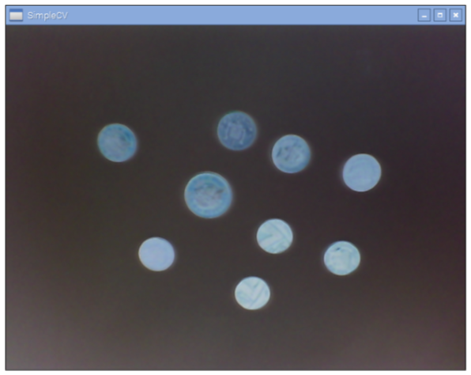
Counting Coins
Circle detection needs the image to be inverted, or you can use a black background. To invert the image and then display it, run the commands below:
SimpleCV:4> i2 = i.invert()
SimpleCV:5> i2.show()
This command makes an inverted copy of i that looks like following figure

Slide 18
Counting Coins
Your image is now prepared, so the next step is to have SimpleCV search for circles using the findCircle command. This command takes three parameters that you will need to tune to prevent misidentification. The parameters are:
canny
This is the threshold for edge detection. In CV terms, an edge is the line between significant changes in the image pixel colors. The default for this parameter is 100, and if you decrease this value, you will find more edges. This might not result in more circles being found because those extra edges might corrupt the good circle shapes. In the case of a coin, the edges could be writing or graphics on the coin.
thresh
Having found edges, the circle detection then needs to decide which are strong enough to represent the circles. Decreasing this value will result in more circles being found.
distance
This parameter sets the required gap (in pixels) between adjacent circles.

Slide 19
Counting Coins
Run the following command to find some circles:
SimpleCV:6> coins = i2.findCircle(canny=100, thresh=70, distance=15) SimpleCV:7> coins
SimpleCV.Features.Detection.Circle at (237,297), SimpleCV.Features.Detection.Circle at (307,323), SimpleCV.Features.Detection.Circle at (373,305), SimpleCV.Features.Detection.Circle at (305,261), SimpleCV.Features.Detection.Circle at (385,253), SimpleCV.Features.Detection.Circle at (243,231), SimpleCV.Features.Detection.Circle at (307,383), SimpleCV.Features.Detection.Circle at (407,371), SimpleCV.Features.Detection.Circle at (235,373)]

Slide 20
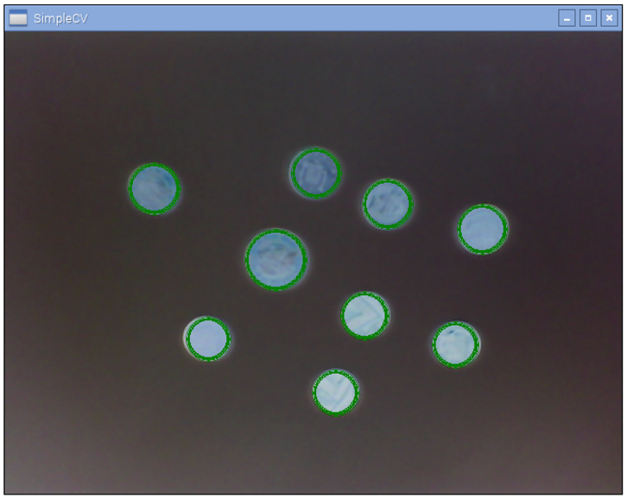
Counting Coins
If you don’t get any coins back, try decreasing the canny and thresh parameters. If you get too many, then increase thresh. We can check that SimpleCV is actually finding coins by superimposing the coin circles onto the original image using the following command.
SimpleCV:8> coins.draw(width=4)
SimpleCV:9> coins.show()
This will show the circles superimposed on the actual coins

Slide 21
Counting Coins
Try moving the coins around and adding and removing coins before capturing another photo and repeating the steps above to make sure things are reliable. You can tweak the parameters until you get the results you want.
We can bundle the commands that we used in the SimpleCV console into a Python program that will (as fast as the Raspberry Pi can) print out the number of coins detected.
from SimpleCV import *
c = Camera()
while True:
i = c.getImage().invert()
coins = i.findCircle(canny=100, thresh=70, distance=1) print(len(coins))
After the initial delay while the library loads and the camera is set up, I found I could get about two “countings” per second using a Raspberry Pi B+. Using a Raspberry Pi 2, this increased to about five readings per second.

Slide 22
Counting Coins
Although not something that you would want to put into a vending machine, it would be an interesting project to use the diameter of the coins to identify their monetary value and add up the value of the coins on the table
You can access the diameter by using the diameter method on one of the coins like this:
SimpleCV:10> coins[0].diameter()
SimpleCV:11> 60

Slide 23
Face Detection
Use the Haar-like feature detection in SimpleCV to analyze an image and pick out the faces.
You will find a suitable file image called faces.jpg. Then run the following commands:
SimpleCV:1> i=Image("faces.jpg")
SimpleCV:2> faces = i.findHaarFeatures('face.xml', min_neighbors=5) SimpleCV:3> faces.draw(width=4)
SimpleCV:4> i.show()

Slide 24
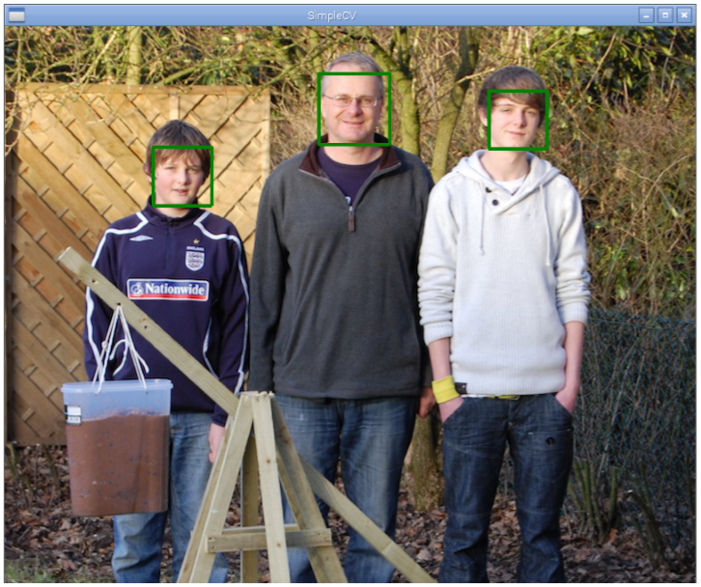
Face Detection
This opens the image viewing window with the faces marked with rectangles, as shown in following figure:

Slide 25
Face Detection
As well as interfacing with a camera, you can also load existing files into SimpleCV. In the previous example, the image i is loaded from the file faces.jpg. The method find HaarFeatures has one mandatory file, which is the type of feature that is being searched for. These features are called haar features and are described by an XML file. SimpleCV comes preloaded with some of these files, but you can also find more specific haar files on the Internet.
The second parameter used in this example (min_neighbors) will tune the haar function. Decreasing min_neighbors increases the number of false positives. When you see the false positives, they often have a face-ish element to them (mouth, nose, and eyes).
There are many built-in haar features. You can list them all by using the command:
SimpleCV:5> i.listHaarFeature()
SimpleCV:4> fullbody.xml', 'face4.xml', 'face.xml', 'upper_body.xml', 'right_ear.xml', 'eye.xml', 'lower_body.xml', 'two_eyes_small.xml', 'nose.xml', 'face2.xml', 'lefteye.xml', 'right_eye.xml', 'two_eyes_big.xml', 'face3.xml', 'mouth.xml', 'glasses.xml', 'profile.xml', 'left_ear.xml', 'left_eye2.xml', 'upper_body2.xml', 'right_eye2.xml', 'face_cv2.xml'

Slide 26
Face Password Project
import picamera
import time
from SimpleCV import Color, Image, np
import RPi.GPIO as GPIO
quality = 400
minMatch = 0.3
RedLED = 18
GreenLED = 23
YellowLED = 24
try:
password = Image("password.jpg")
except:
password = None
mode = "unsaved“
saved = False
minDist = 0.25

Slide 27
Face Password Project
GPIO.setmode(GPIO.BCM)
GPIO.setup(RedLED, GPIO.OUT)
GPIO.setup(GreenLED, GPIO.OUT)
GPIO.setup(YellowLED, GPIO.OUT)
with picamera.PiCamera() as camera:
while True:
camera.start_preview()
time.sleep(10)
camera.capture('pifacepw.jpg')
image=Image("pifacepw.jpg")
camera.stop_preview()
faces = image.findHaarFeatures("face.xml")
if faces:
if not password:
faces.draw()
face = faces[-1]
password = face.crop().save("password.jpg")
print "First Run Application"
print "Exit Program"
break

Slide 28
Face Password Project
else:
faces.draw()
face = faces[-1]
template = face.crop()
template.save("passwordmatch.jpg")
template = Image("passwordmatch.jpg")
diff = template.resize(password.width, password.height) - password;
#keypoints = password.findKeypointMatch(template, quality, minDist, minMatch)
if diff.findBlobs(minsize = 1000):
print "Face not matched"
print "Danger"
GPIO.output(GreenLED, 0)
GPIO.output(RedLED, 1)
GPIO.output(YellowLED, 0)
else:
print "your face detected and matched"
print "Welcome to Application"
GPIO.output(GreenLED, 1)
GPIO.output(RedLED, 0)
GPIO.output(YellowLED, 0)

Slide 29
Face Password Project
else:
print "No face found"
print "Please look at the camera"
GPIO.output(GreenLED, 0)
GPIO.output(RedLED, 0)
GPIO.output(YellowLED, 1)

Slide 30
Motion Detection
Use SimpleCV to detect changes between successive frames from the camera. The program below compares each captured image with the previous image. It then detects any blobs (areas of similar color) in the difference image and if there are any larger than MIN_BLOB_SIZE, it prints out a message saying that movement was detected.
from SimpleCV import *
MIN_BLOB_SIZE = 1000
c = Camera()
old_image = c.getImage()
while True:
new_image = c.getImage()
diff = new_image - old_image
blobs = diff.findBlobs(minsize=MIN_BLOB_SIZE)
if blobs :
print("Movement detected")
old_image = new_imag
Successive frames of the image might look like following figure. When the first image is subtracted from the first, the resulting image will look like next Figure. Running blob detection on it will result in the outlined blobs shown in Next Figure.

Slide 31
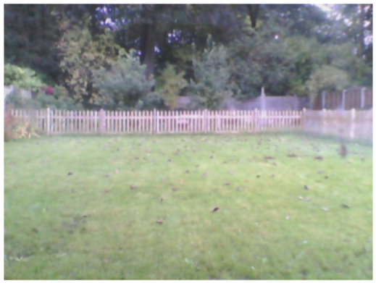
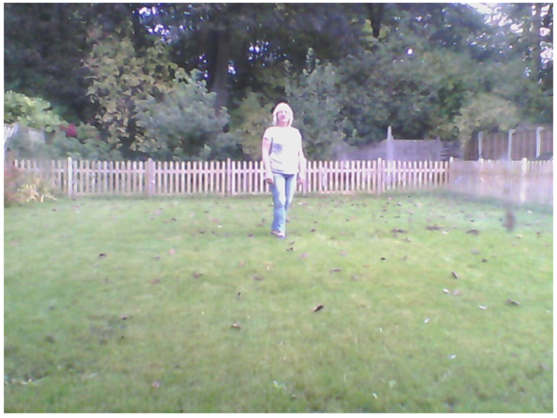
Motion Detection

Slide 32
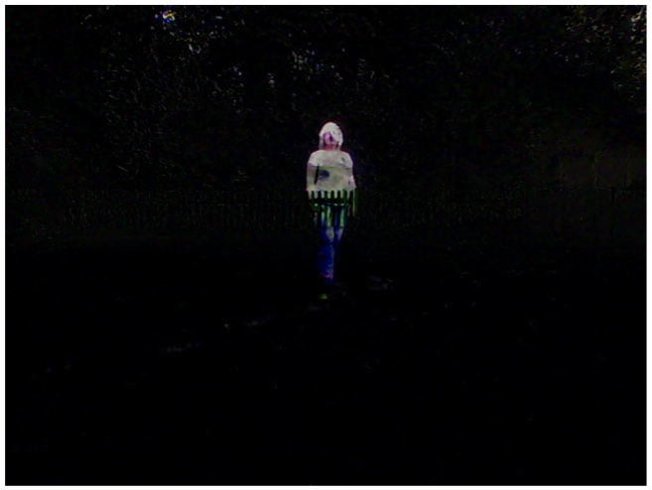
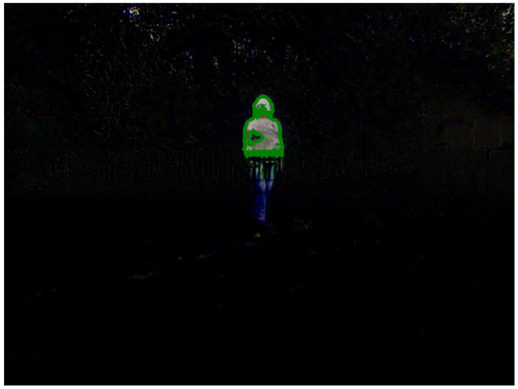
Motion Detection

Slide 33
Optical Character Recognition
Use the tesseract Optical Character Recognition (OCR) software to extract text from the image.
To install tesseract, run the following commands:
$ sudo apt-get install python-distutils-extra tesseract-ocr tesseract-ocr-eng
libopencv-dev libtesseract-dev libleptonica-dev python-all-dev swig libcv-dev python-opencv python-numpy python-setuptools build-essential subversion
$ sudo apt-get install tesseract-ocr-eng tesseract-ocr-dev libleptonica-dev
python-all-dev swig libcv-dev
$ sudo svn checkout
http://python-tesseract.googlecode.com/svn/python-tesseract-0.7.4/
$ cd python-tesseract-0.7.4
$ sudo python setup.py build
$ sudo python setup.py install

Slide 34
Optical Character Recognition
To try out tesseract, you will need an image file that contains some text.
$ tesseract ocr_example.png found
Tesseract Open Source OCR Engine v3.02 with Leptonica
$ more found.txt
The quick brown fox jumped over
the lazy dogs back.
$
The tesseract library will work with most image types, including PDF, PNG, and JPG files.
For more information on the tesseract library, see https://github.com/tesseract-ocr/ tesseract/wiki/TrainingTesseract.

Slide 35


Contact us
www.e-system.ir
Info@e-system.ir

